Slide 1

Project Setup Training
January 16, 2020

Slide 2

AGENDA
Project Setup Prerequisites
Completing the Project Setup Form
Setup Form Activity

Slide 3

PRE-SETUP CHECKLIST
Opportunity (OPPO#)
SNC
WA Pending
Proposal (PROP#)
Fully Executed Contract
Marketing Approved Project Description

Slide 4
MUST FOLLOW THIS LINK FOR PROJECT SETUP FORM.
Z:\Standard Forms\Project Delivery System Policies and Procedures\5. Project Execution\Project Setup

Slide 5
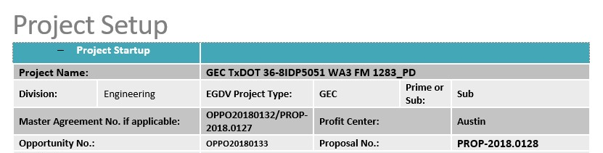
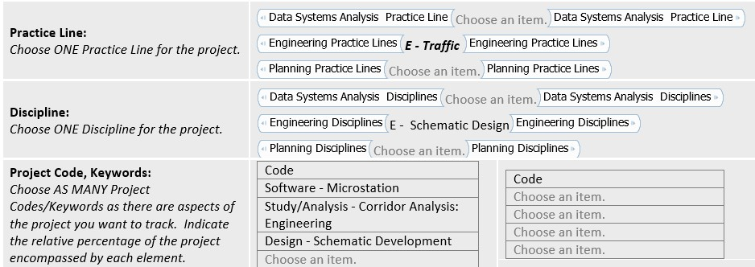
PROJECT INFO SECTION
Project Name:
Contract # (if applicable)
WA#
Project Description
Prime (if applicable)
EGDV-ers: Need Project Signifier*

Slide 6
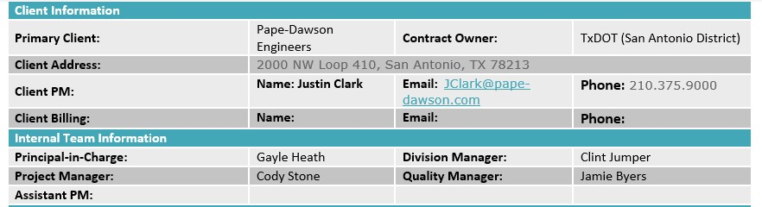
CLIENT – TEAM INFO
Primary Client – who ATG is contracted with
Contract Owner – Entity that awarded contract to Prime
CONFIRM CLIENT BILLING!
PLDV- Jory
EGDV-Clint
Data- TBD
MUST have a QM listed
PIC is individual responsible for the contract
Can be found in OPPO #

Slide 7
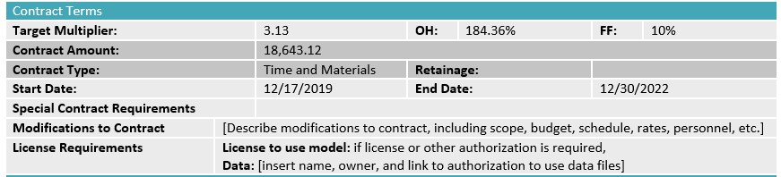
CONTRACT TERMS
Most of the info below can be found in contract
Don’t forget to check the Master
Check fee schedule
Target multiplier: (1 + OH Rate) x (1 + FF)
2.8436 x 1.10 = 3.13

Slide 8
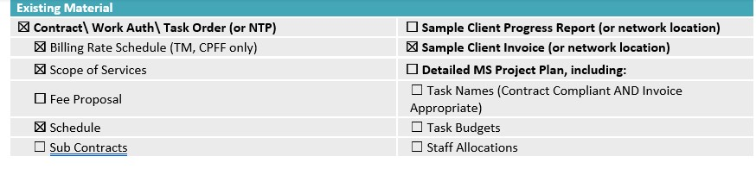
PROJECT DOCUMENTS
Tasks will be setup according to how projects needs to be invoiced
Include other communication pertaining to the project that may be relevant i.e. invoice calendar, contact information, client preferences, etc.

Slide 9
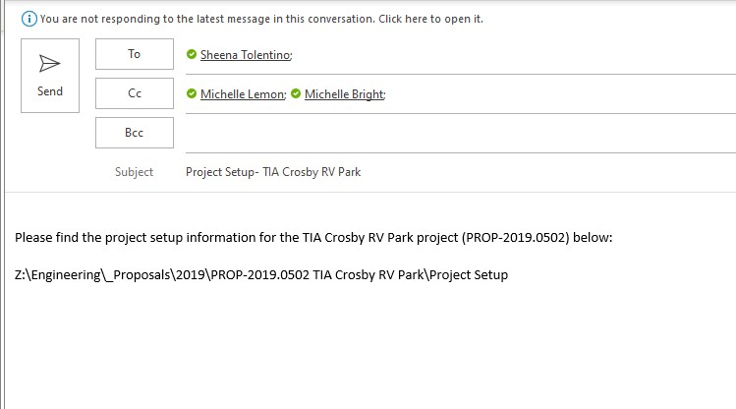
OKAY WHAT NOW?
Send us a path link to all required info in an email
No we don’t only setup projects on Fridays
Send us your setup request as soon as you have everything ready!

Slide 10
QUESTIONS????

